Slide 1

Online Payment Fraud Detection Model
Designed & Built By
Pravina Prajapati - N01579926
Vraj Patel - N01581006
Param Panchal - N01579822
Dhairya Dangi - N01580705
Prappan Batra - N01579150

Slide 2
Agenda
Concept & Motivation
Proposed Solution : Ideation & Workflow
Utilized Data : Schema & Characteristics
Exploratory Insights
Data Wrangling : Cleaning, Encoding & Generating Features
Data Splitting & Down Sampling
Feature Selection Checks : Low Variance, Correlation & BORUTA
Anomaly Detection Models : A comparative analysis
Conclusion

Slide 3
Online Frauds: Base Concept & Motivation
Rising Threat of Online Payment Fraud: Online payment fraud is a growing concern as unauthorized transactions increase across e-commerce, mobile payments, and online banking.
Significant Financial Impact: Estimated losses from online payment theft could exceed $200 billion by 2024, emphasizing the urgency for robust fraud detection systems.
Need for Dynamic Fraud Prevention: Effective fraud prevention requires a strategic blend of verification tools and advanced machine learning techniques to combat evolving fraud tactics.

Slide 4
Proposed Solution: Ideation
Focus Shift in Fraud Detection: The research suggests prioritizing data preprocessing, dedicating 80% of efforts to data wrangling and only 20% to machine learning algorithms.
Data Preparation Strategy: The project involves comprehensive exploratory data analysis, cleaning, and feature generation to simplify data and improve model accuracy.
Handling Imbalanced Data: To address the low target rate (0.19%), the training dataset is down-sampled to a 5% target rate, ensuring better model performance.
Model Training Approach: The refined dataset is used to train four anomaly detection models: Isolation Forest, One Class SVM, Autoencoder Neural Network, and Elliptical Envelope.

Slide 5
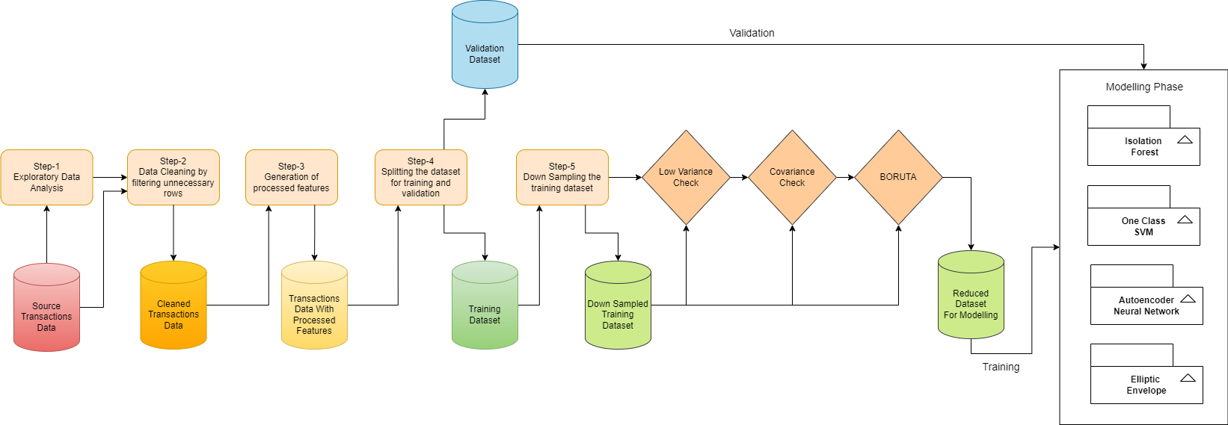
Proposed Solution: Workflow

Slide 6
Utilized Data : Excavation & Characteristics
Data Source : Kaggle (Data Uploader’s Name: JAINIL SHAH)
Synthetic Dataset: The PaySim simulator generated the dataset, mimicking real transactions with embedded malicious behaviors.
Data Parameter | Value
Byte size (while downloading) | 186 MB
Number of rows (First look) | 6,362,620 (Around 6.36 million records)
Number of columns (First look) | 11
Target Column | isFraud
Type of data | Synthetic (generated artificially)

Slide 7
Utilized Data : Schema
Column Name | DataType | Description
step | Int64 | Maps a unit of time in the real world. In this case 1 step is 1 hour of time. Total steps 744 (30 days simulation).
type | String | Type of online transaction: CASH-IN, CASH-OUT, DEBIT, PAYMENT and TRANSFER
amount | Float64 | The amount of the transaction
nameOrig | String | Customer starting the transaction
oldbalanceOrg | Float64 | Balance before the transaction
newbalanceOrig | Float64 | Balance after the transaction
nameDest | String | Recipient of the transaction
oldbalanceDest | Float64 | Initial balance of recipient before the transaction
newbalanceDest | Float64 | The new balance of recipient after the transaction
isFraud | Int64 | Target attribute: This is the transactions made by the fraudulent agents inside the simulation.
isFlaggedFraud | Int64 | The business model aims to control massive transfers from one account to another and flags illegal attempts.

Slide 8
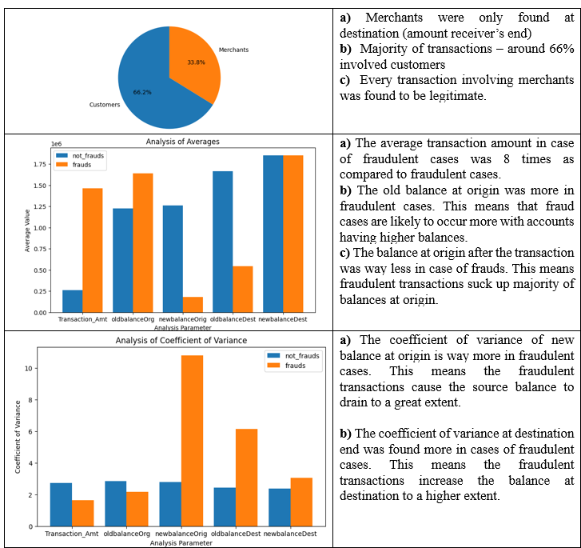
Exploratory Insights
Initial Data Analysis: The analysis began with examining the dataset, focusing on the "isFraud" column.
Focus on "isFlaggedFraud": It was determined that the "isFlaggedFraud" column, indicating canceled transactions, should be excluded from further analysis.
Data Cleaning: Removing the 16 rows labeled as "isFlaggedFraud" also eliminated 16 positive fraud samples.
Exploratory Data Analysis: The next step involved detailed exploration of the "isFraud" column across various parameters.

Slide 9
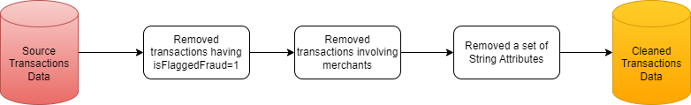
Data Wrangling: Cleaning & Encoding
Data Cleaning Steps: Removed 16 rows with "isFlaggedFraud" as 1, following the dataset's documentation.
Merchant Transactions Exclusion: Transactions involving merchants were removed as they were not linked to fraud, reducing non-fraudulent samples.
Column Reduction: Removed irrelevant string columns, keeping only numerical columns and the target attribute "isFraud.“
Label Encoding: The "type" column was label encoded, converting transaction types into numeric values, before proceeding to feature generation.

Slide 10
Data Wrangling: Feature Generation
Standard Feature Columns: The dataset included transaction amounts and account balances at origin and destination points.
Processed Columns Creation: New columns were generated by calculating the difference between balance columns.
Enhanced Data Fit: These processed columns were created to improve model performance in anomaly detection.
Feature | Description
diff_newbalanceDest_oldbalanceDest | Difference between newbalanceDest & oldbalanceDest
diff_newbalanceDest_newbalanceOrig | Difference between newbalanceDest & newbalanceOrig
diff_newbalanceOrig_oldbalanceOrg | Difference between newbalanceOrig & oldbalanceOrg

Slide 11
Data Splitting & Down Sampling
Dataset Overview: After cleaning and transformation, the dataset had 4,211,109 rows and 10 columns, with a low target rate of 0.19% for fraud.
Down Sampling Strategy: The dataset was split into 80% training and 20% validation sets, with only the training set down sampled to increase the target rate to 5%.
Model Validation: The validation set remained unsampled to ensure models trained on the down sampled set are tested in a realistic environment with low fraud rates.
Dataset | Total Number of rows | Number of 0s in target | Number of 1s in target | Target Rate
Training Set – Unsampled | 3368888 | 3362330 | 6558 | 0.19%
Training Set – Down Sampled | 131558 | 125000 | 6558 | 5%
Validation Set | 842221 | 840582 | 1639 | 0.19%

Slide 12
Feature Selection : The Low Variance Check
Ensuring processed features have considerable variance is key to preventing model overfitting.
The down sampled training dataset was tested with a low variance filter to assess data spread.
A threshold of 0.25 was used for “type” feature & 25,000 for rest of the features
All data columns passed the variance check, indicating a wide and random distribution of values.
All features were pipelined next to the correlation check

Slide 13
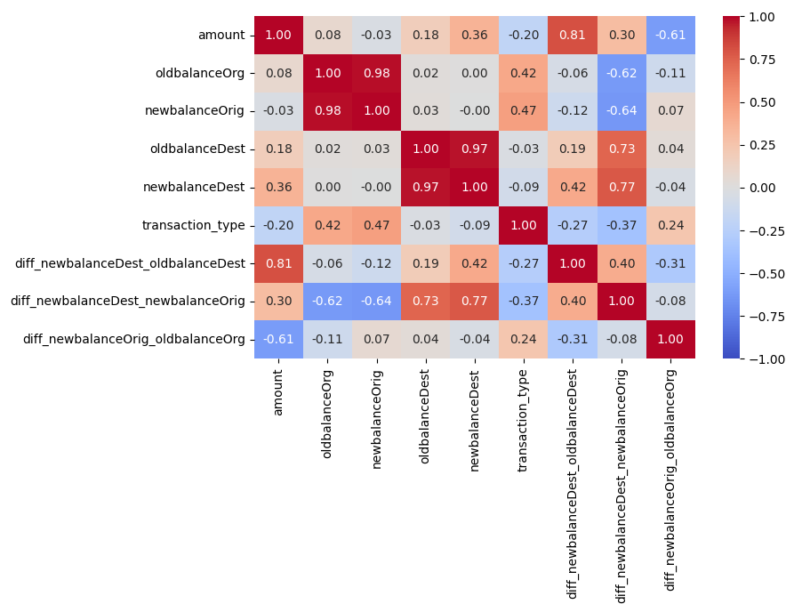
Feature Selection : The Correlation Check
A correlation threshold of 0.85 was used, leading to the removal of one of the highly correlated columns based on the following correlation matrix
Two columns, "oldbalanceOrg" and "oldbalanceDest," were removed, reducing the dataset to 6 feature columns.

Slide 14
Feature Selection : BORUTA Check
Boruta Overview: Boruta is a feature selection method that identifies relevant features by comparing them with randomized shadow features.
Methodology: It uses a machine learning model, typically a random forest, to assess feature importance scores.
Selection Process: Features significantly more important than shadow features are retained, while less important ones are discarded.
Implementation: The Boruta check was performed with 100 iterations using the BorutaPy library.
Outcome: All 6 features passed the Boruta check and were processed for the next phase of modeling.

Slide 15
Model Training: Isolation Forest
Training and Testing: Models were trained on the down sampled dataset and tested on an unsampled validation set to ensure real-time performance.
Isolation Forest Overview: Isolation Forest detects outliers by isolating data points using random feature splits.
Algorithm Process: It partitions data into a tree structure where anomalies are isolated with shorter path lengths.
Efficiency: The algorithm is efficient and effective with high-dimensional data.

Slide 16
Model Training: Support Vector Machines
Algorithm Overview: One-Class SVM is an unsupervised learning algorithm for anomaly detection.
Normal Data Modeling: It finds a decision boundary that best covers the majority of training data points.
Boundary Classification: Points outside this boundary are classified as anomalies.
Kernel Function: The algorithm maps data into a higher-dimensional space using a kernel function.
Application: Effective in scenarios with mostly normal data and few anomalies, such as fraud detection.

Slide 17
Model Training: Autoencoder Neural Nets
Autoencoder Overview: A neural network used for dimensionality reduction, feature learning, and anomaly detection.
Network Structure: Comprises an encoder that compresses data and a decoder that reconstructs it.
Training Objective: Trained to minimize reconstruction error, with anomalies showing higher errors.
Flexibility: Can be adapted with different layers or activation functions for various data types.

Slide 18
Model Training: Elliptic Envelope
Elliptic Envelope Overview: Models data using a multivariate normal distribution to fit an ellipsoid around central data points.
Anomaly Detection: Points outside the ellipsoid are considered anomalies.
Estimation: Uses the mean and covariance of the data to define the ellipsoid’s shape and orientation.
Application and Limitation: Effective for Gaussian-like data and outlier detection in multivariate datasets but may struggle with complex or non-Gaussian distributions.

Slide 19
Comparative Analysis: Validation Metrics
The following performance metrics were generated from testing the performance of the aforementioned models on the unsampled validation data
Model | Accuracy | Precision | Recall | AUC
Isolation Forest | 91.45% | 0.85% | 3.71% | 64.32%
One Class SVM | 81.18% | 0.47% | 44.97% | 63.11%
AutoEncoders | 89.86% | 0.28% | 14.34% | 52.17%
Elliptic Envelope | 96.74% | 3.90% | 66.69% | 81.74%
Selected Model : Elliptic Envelope
Elliptic Envelope Outperforms other algorithms in accuracy, precision, recall, and AUC.
Isolation Forest, Autoencoders, and One-Class SVM show lower performance, with issues in identifying fraudulent transactions.

Slide 20
Conclusion
Elliptic Envelope Effectiveness: The model effectively analyzes high volumes of fraudulent transactions in the dataset.
Monitoring and Refinement: Continuous monitoring and refinement are necessary to address potential accuracy degradation due to data drifts.
Enhanced Detection: Confidence in detecting fraud can be increased by observing patterns like sequential dependencies and specific transaction types.
Manual Checks: Incorporating manual checks for transaction sequences and types can complement machine learning results for more accurate fraud detection.

Slide 21
Thank you
We are happy to take your questions

